Slide 1
Blanchard Institute
April 8, 2025
Organic Social Media Report

Slide 2
Quarterly Overview
In Q1, The Blanchard Institute and Snapshot expanded their partnership to include the production of organic social media content. After three months, we’ve accomplished the following:
Facebook clicks increased by 95%
Facebook impressions increased by 30%
Instagram engagements increased by more than 2,000%
Instagram engagement rate increased by more than 600%
LinkedIn clicks increased by more than 980%
LinkedIn engagements increased by more than 1,000%

Slide 3
Facebook Performance & Analysis
KPI | Q4 Performance
Published Posts | 52 (-17.5%)
Audience Growth | 2,246 (+2.2%)
Total Engagements | 1,472 (-55.8%)
Clicks | 41 (+95.2%)
Impressions | 65,834 (+30%)
Engagement Rate | 2.2% (-65%)
On Facebook, there was a 17% decrease in published posts, which limits opportunities to generate engagement and impressions—as reflected in the data.
When impressions increase but engagement declines, it's natural for overall engagement to follow suit.
However, it's important to stay focused. Impressions and clicks have both increased significantly. From this data set, we can infer that more users are seeing our content and clicking for more information. While not everyone who sees our content is engaging with it, we’re still growing our audience.

Slide 4
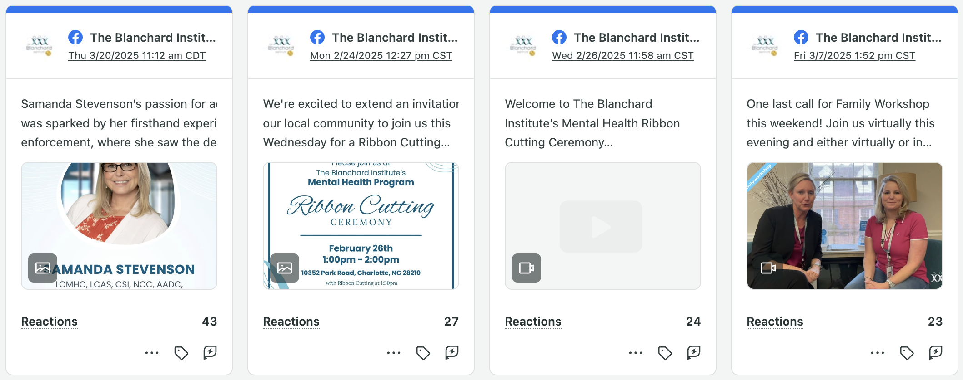
Top Facebook Posts

Slide 5
Instagram Performance & Analysis
KPI | Q4 Performance
Published Posts | 45 (+2,150)
Audience Growth | 746 (+1.57%)
Total Engagements | 89 (+2,125%)
Impressions | 2,408 (+189.8%)
Engagement Rate | 3.7% (+667.8%)
On Instagram, we experienced the positive effects of increased post volume and activity. With more opportunities to generate engagement and impressions, we’ve capitalized—improving performance across all indicators.
Note the relationship between engagements, impressions, and engagement rate. Unlike Facebook, our content is not only being seen by many users but is also driving higher levels of interaction. That’s why our engagement rate has skyrocketed.
With explosive growth like this, we can expect results to level out in Q2—especially if post volume decreases.

Slide 6
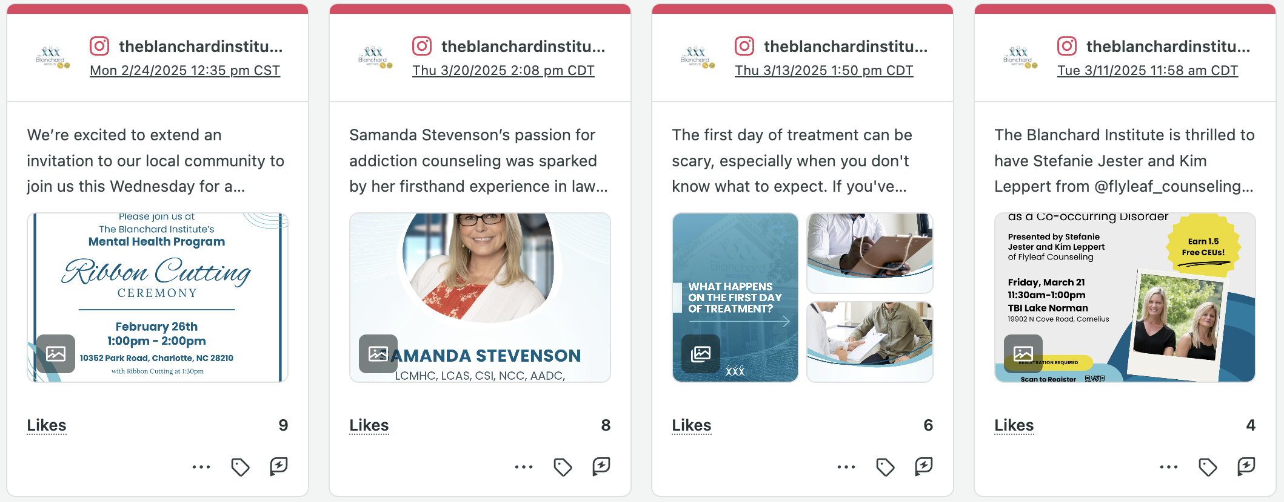
Top Instagram Posts

Slide 7
LinkedIn Performance & Analysis
KPI | Q4 Performance
Published Posts | 13
Audience Growth | 989 (+2.8%)
Total Engagements | 212 (+1,147.1%)
Clicks | 163 (+986.7%)
Impressions | 2,121 (+377.7%)
Engagement Rate | 10% (+161.1%)
On LinkedIn, we’ve seen explosive growth similar to what we experienced on Instagram. This performance further reinforces the relationship between engagements, impressions, and engagement rate.
With sharp increases in both engagements and impressions, it's natural to see the engagement rate rise as well.
However, the most significant wins are audience growth and increased link clicks. This shows that LinkedIn users aren’t just seeing our content—they're actively seeking more information and driving traffic to the website.

Slide 8
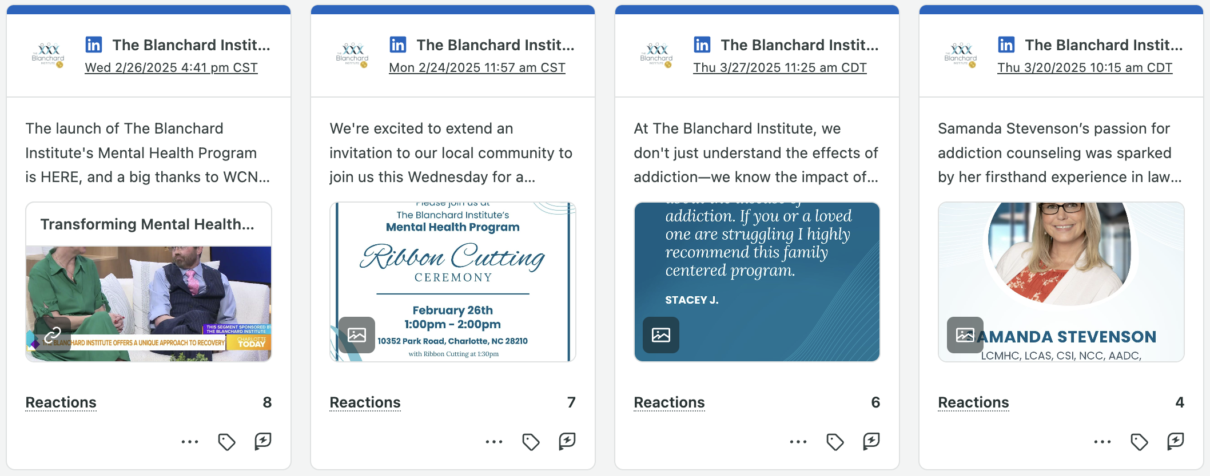
Top LinkedIn Posts

Slide 9
Looking Forward
In Q1, we significantly increased our posting activity on Instagram and LinkedIn, which helped establish a new baseline for performance. As a result, we saw a sharp uptick in engagement and reach.
However, with these historic highs now serving as our new normal, continued growth in Q2 would require either a sustained increase in content volume or standout, anomaly-level performance. Without those factors, it's natural to see a plateau or slight dip as we stabilize.
Team related content has been a top performer for The Blanchard Institute, In Q2, we'll focus more on utilizing this pillar to generate engagement and impressions. This will include requests for videos, Q&As and content drafted by Snapshot and answered by the Blanchard Institute team.

Slide 10
Thank You

